Slide 1
Submitting Exercises via GitHub

Slide 2
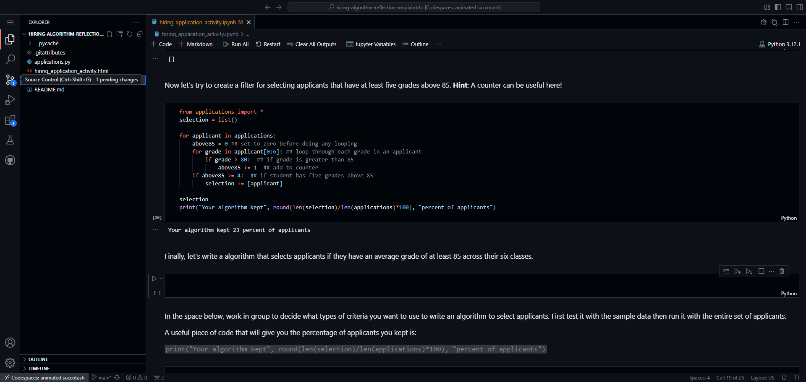
1. From the Codespace page with your code, you want to click the Source Control tab (green box).

Slide 3
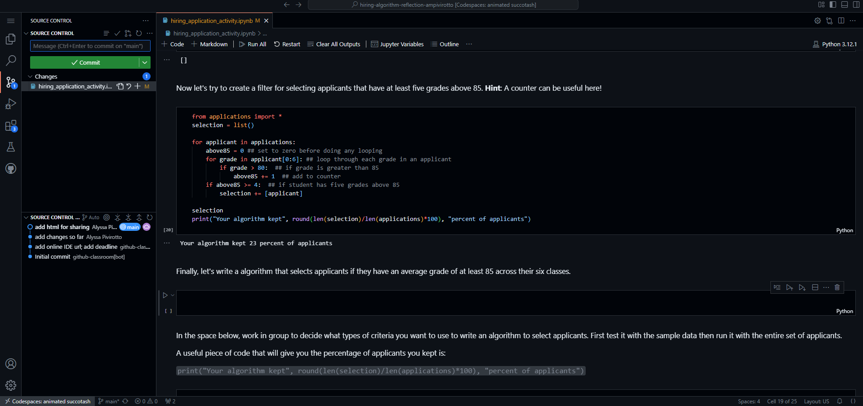
2. This brings up the Source Control panel which should show the files that you changed (likely just the hiring_application_activity.ipynb)

Slide 4
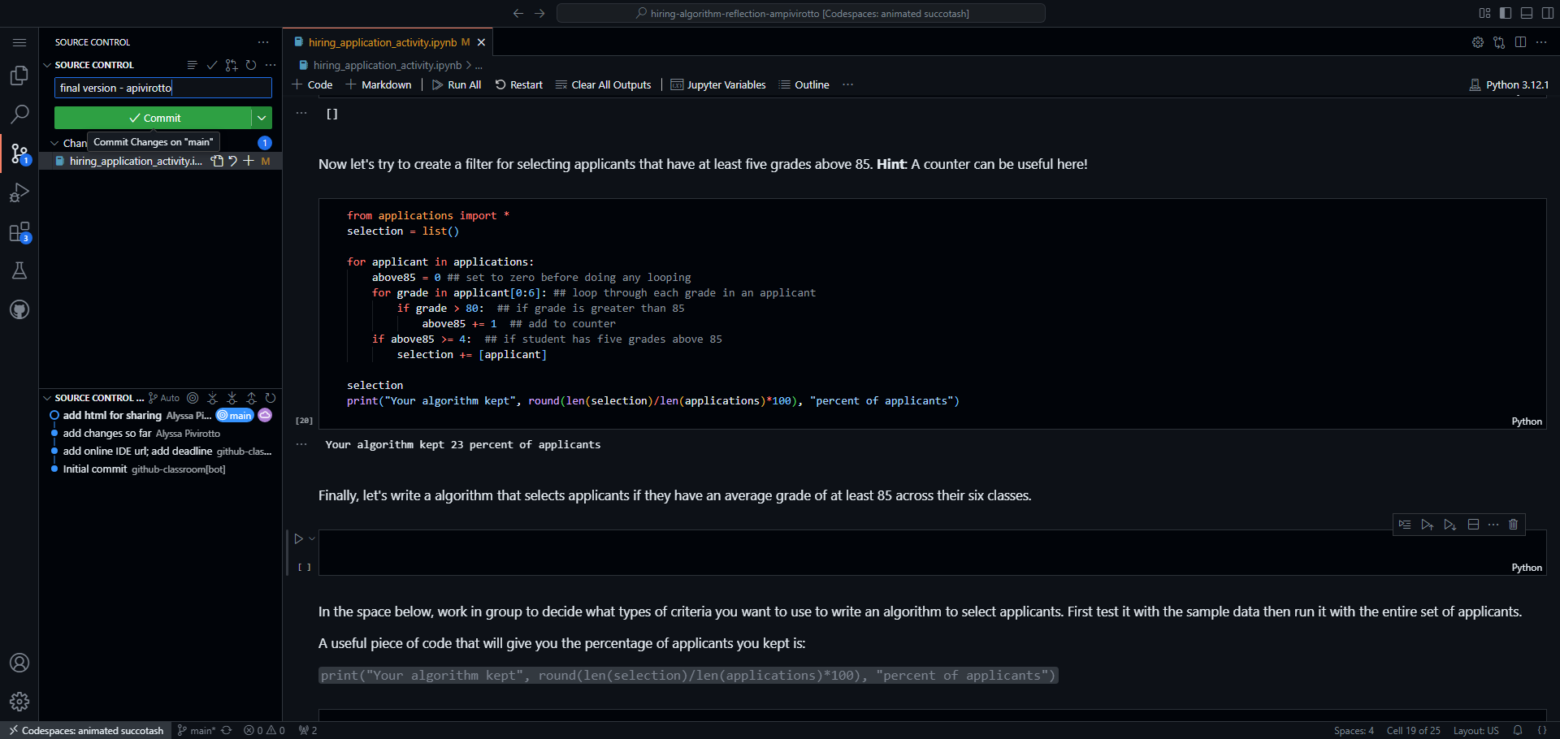
3. Give your changes a name. If this is your final version versus just an intermediate version, it can be good to notate that with the message (green box). Then click the green Commit button.
1
2

Slide 5
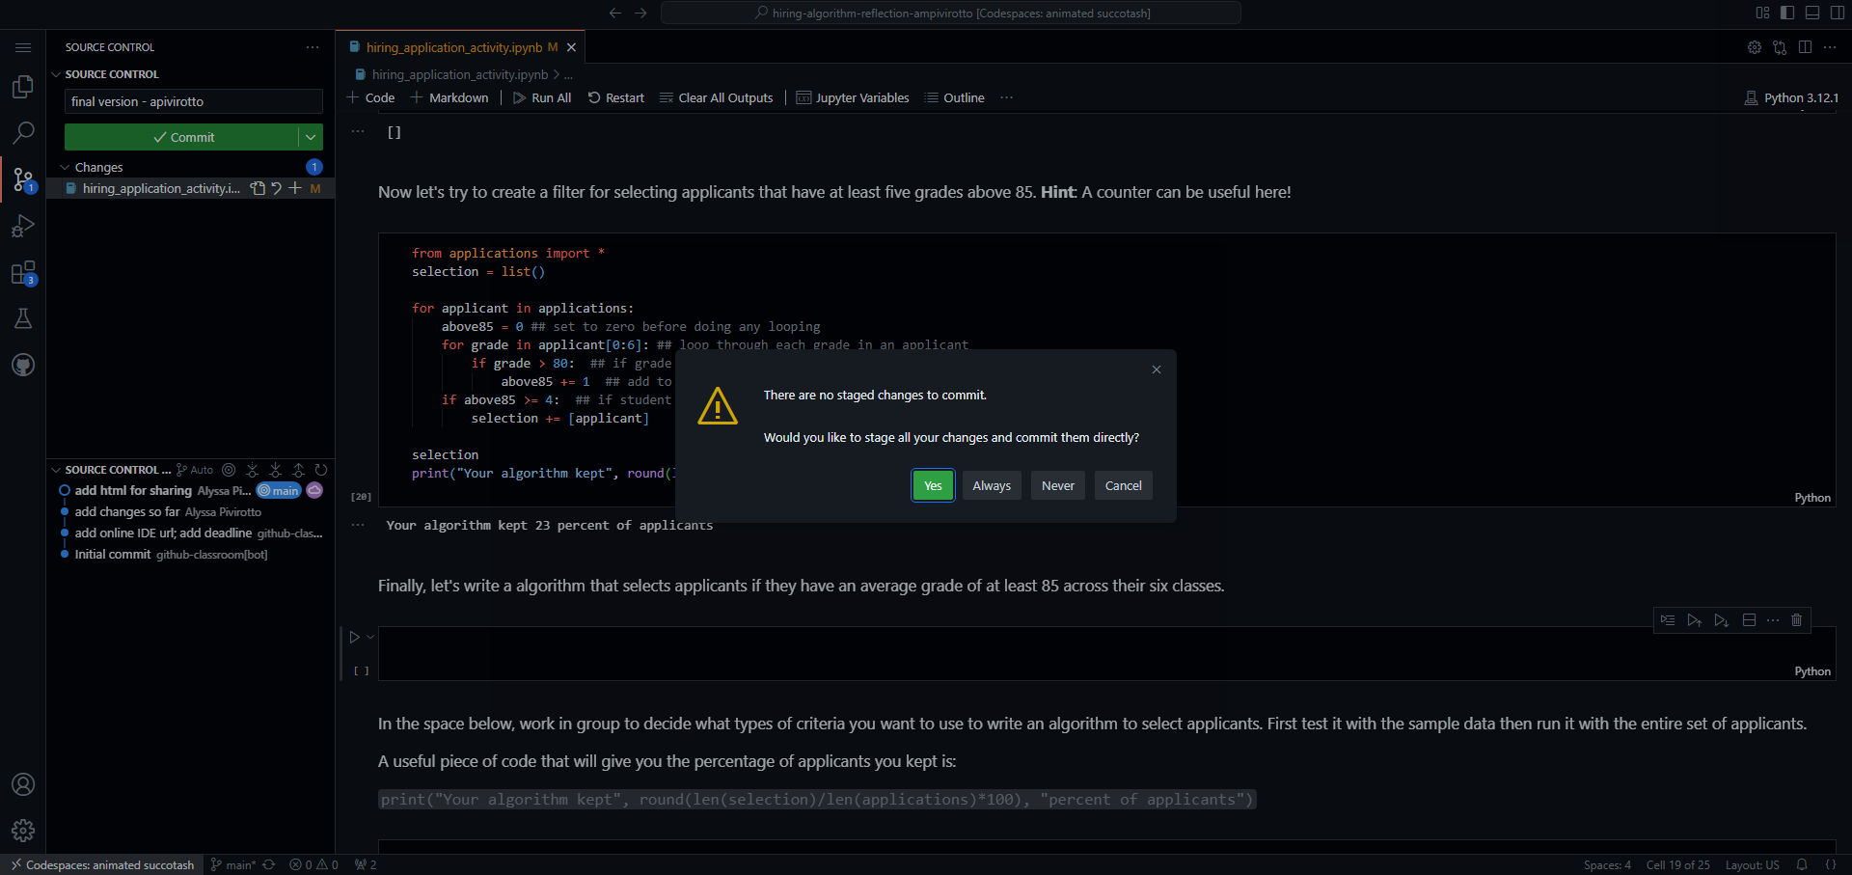
4. It will ask you if you want to stage all your changes – click ‘Yes’. This is essentially saying that you want to include all your changes in the commit.

Slide 6
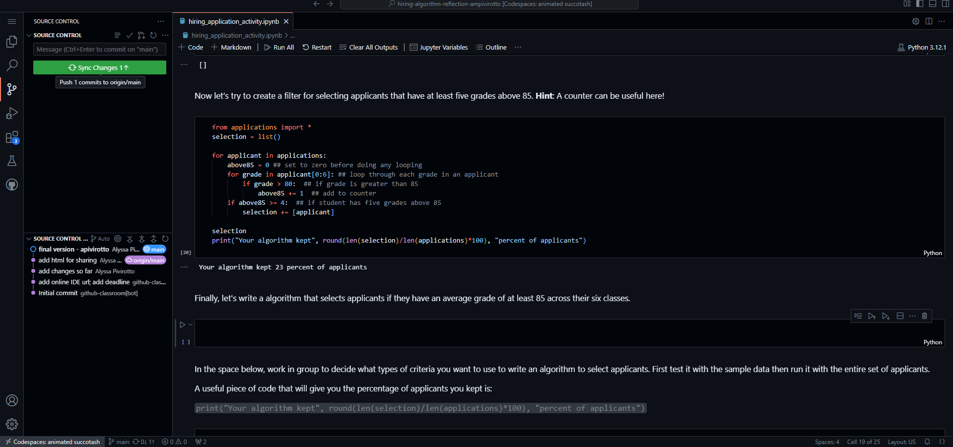
5. Click the ‘Sync Changes’ button which will push your updates to your repository making them public.

Slide 7
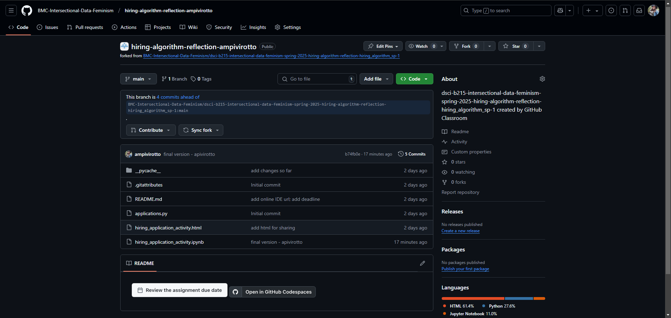
6. You can check to make sure this worked by looking for your commit message in your repository.

Slide 8
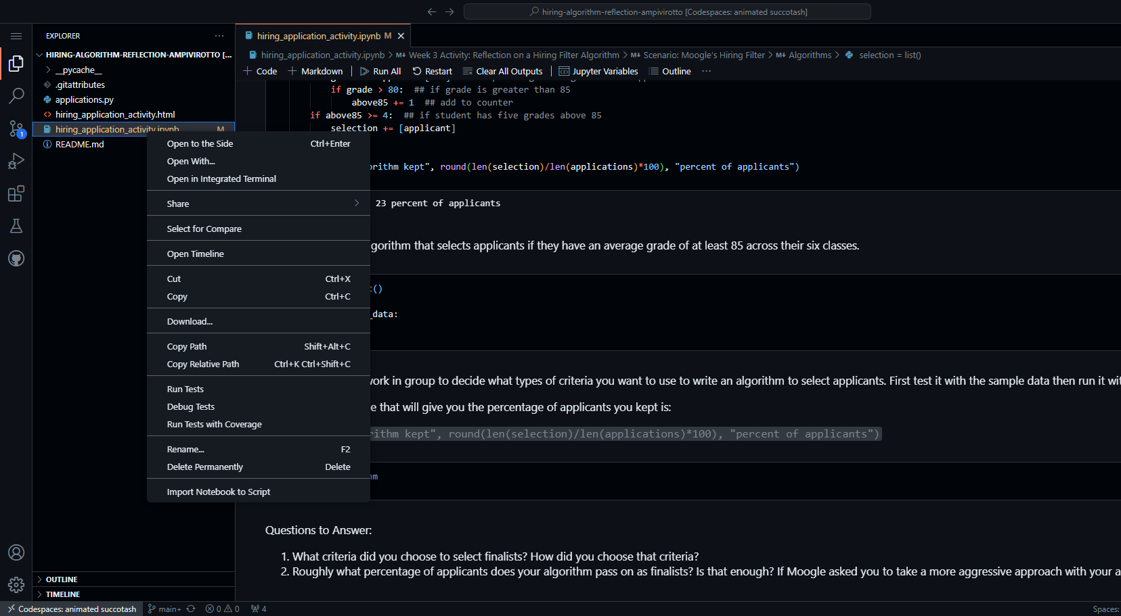
If you have issues making commits or syncing the changes, please download your file and email me the file. You can do this by right-clicking on the Jupyter Notebook file in the ‘Explorer’ tab and then selecting the ‘Download…’ option.

